Slide 1
GYM MANAGEMENT SYSTEM

Slide 2
INTRODUCTION
USES OF THE PROJECT
Streamlines and optimizes daily operations of gyms
User-friendly interface
Easy management of users, members, trainers.
Perfect solution for gym owners and managers

Slide 3
ENTITIES
USERS
MEMBERS
WORKOUT_PLAN
TRAINER
PAYMENT

Slide 4
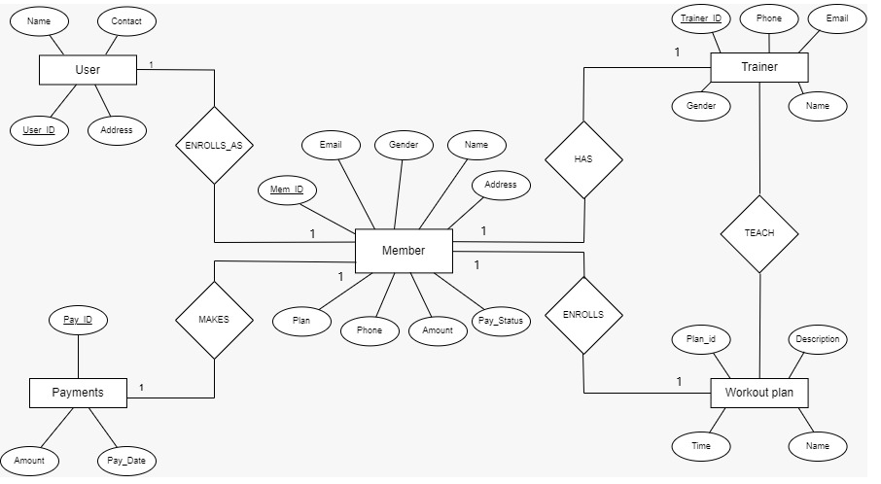
E R DIAGRAM

Slide 5
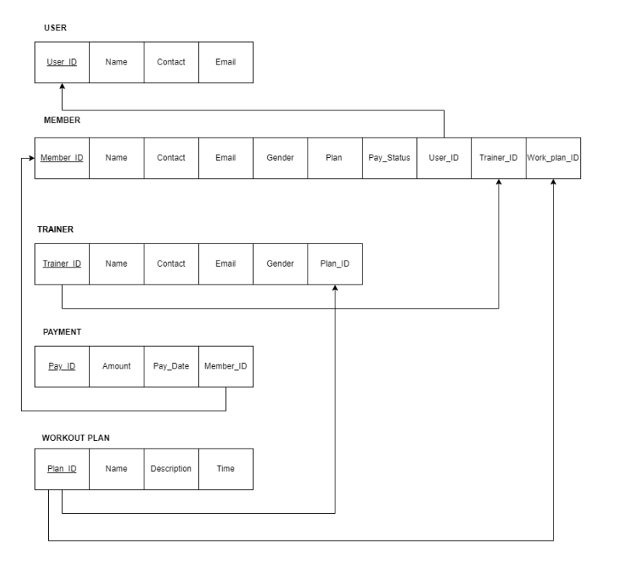
SCHEMA DIAGRAM

Slide 6
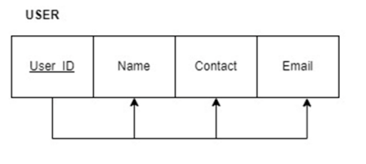
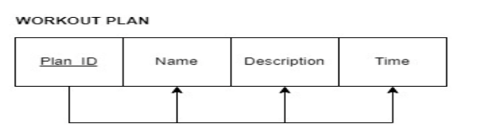
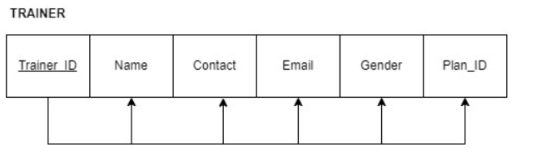
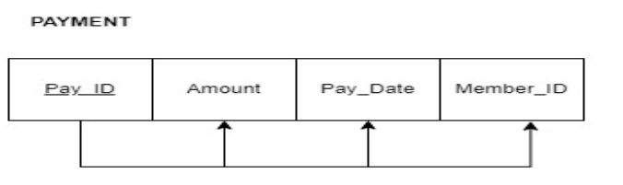
NORMALIZATION

Slide 7
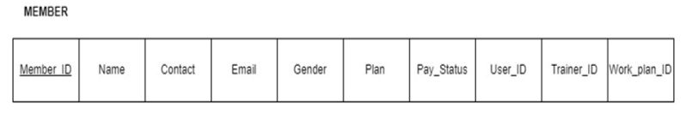
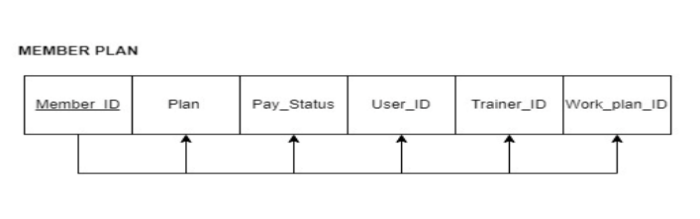
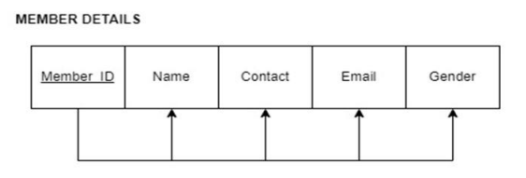

Slide 8
THANK YOU

